Slide 1
MCA 105-Operating System with Linux as case study

Slide 2
Agenda
Introduction to Operating System

Slide 3
Semester 1 MCA 105 Operating System with Linux as case study
Module1-File System concepts, Access methods, Allocation methods, Directory systems, File protection. Disk Management-Disk scheduling, Disk management, Disk reliability.Linux: History of Linux: Linux Operating System Layers, The Linux Shell Process: (parent and child processes), Files and Directories (File Structure and directory structure), Linux Basic commands: pwd, cd, mkdir, rm, mv, touch, man, cp, locate, echo, cat, touch, ls, cut, paste and other basic shell management commands
Module2 -Memory Management - Memory partitioning, Swapping, Paging, Segmentation, Virtual memory, Demand paging, Page replacement algorithms, Allocation algorithms.Linux Commands: df, du, tar, zip, uname, chmod, head, tail, sort, grep, sudo privileges, top, free, vmstat, and other memory related commands. Installation of Linux OS
Module 3-Process Management and Concurrency management Process and Thread Management, Concept of process and threads, Process states, Process management, Context switching, Multithreading, Concurrency Control, Concurrency and Race Conditions.Linux: process related commands: fork, exec, ps, kill, nice, foreground process, background process
Module 4-Concurrency Management - Semaphores, Classical IPC problems and solutions. Deadlock, Characterization, Avoidance and Prevention, Detection, Recovery.Linux: Shell variables, redirection, filters, Shell Scripting,

Slide 4
Semester 1 MCA 105 Operating System with Linux as case study
Module 5- Protection and case study: LINUX - Access matrix, Implementation of access matrix, Revocation of access rights. Linux OS–Administering Users and Groups: Administering User Accounts, Working with Group Accounts, Understanding the Root Account, installing packages

Slide 5
Course objectives
To provides a comprehensive introduction to understand the underlying principles, techniques and approaches used in operating systems
To understand how OS, manage resources such as memory, peripherals, and schedule CPU time and learn how applications communicate with the user and the underlying hardware

Slide 6
Graduate Attribute Tools
Written Assignment
The assignments are to be submitted on time. Late submission will lead to the reduction of internal marks. Questions will be provided in due course of the lecture sessions.
Viva Voce
The students will have to attend a viva-voce personally. The schedule will be announced in the class.

Slide 7

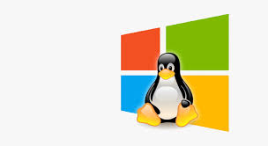


What is an Operating System?
A program that acts as an intermediary between a user of a computer and the computer hardware.
Operating system goals:
Execute user programs and make solving user problems easier.
Make the computer system convenient to use.
Use the computer hardware in an efficient manner.

Slide 8
Computer System Structure
Hardware
Operating system
Application programs
Users

Slide 9
What is an Operating system
Operating system

Slide 10
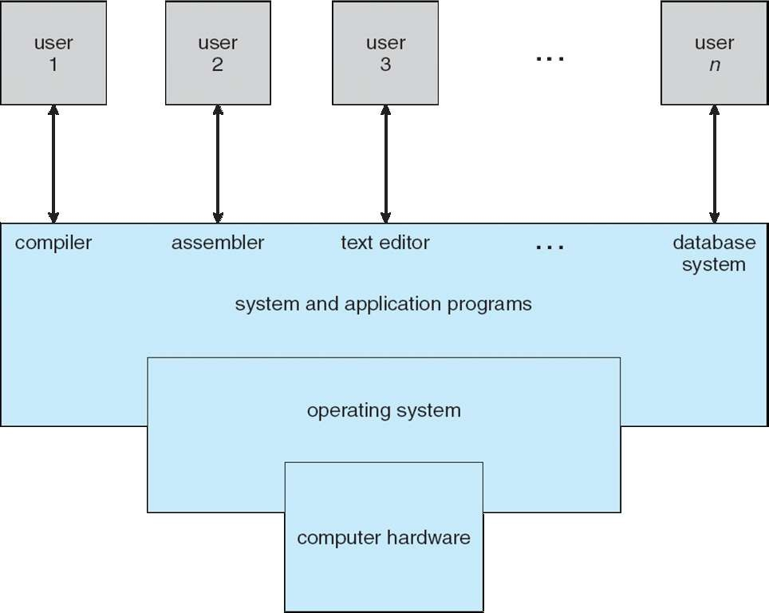
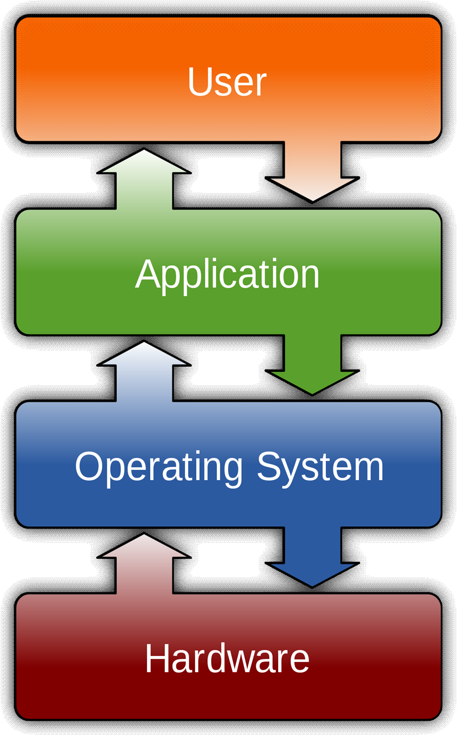

The dominant desktop operating system is Microsoft Windows with a market share of around 82.74%. macOS by Apple Inc. is in second place (13.23%), and the varieties of Linux are collectively in third place (1.57%).

Slide 11
What Operating Systems Do
Users want convenience, ease of use and good performance
Windows
Throughput-
Linux

Slide 12
Operating System Definition
Resource Allocator
Manages all resources
Decides between conflicting requests for efficient and fair resource use
Control Program
Controls execution of programs to prevent errors and improper use of the computer

Slide 13
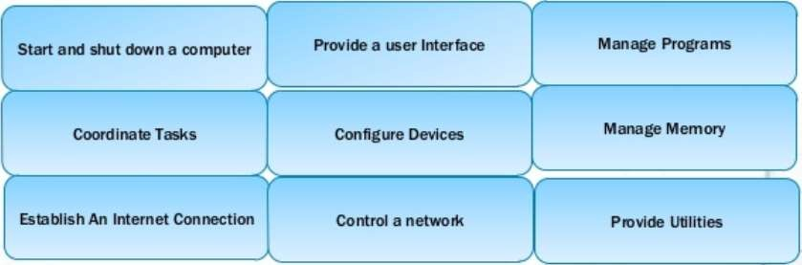
Control Program

Slide 14
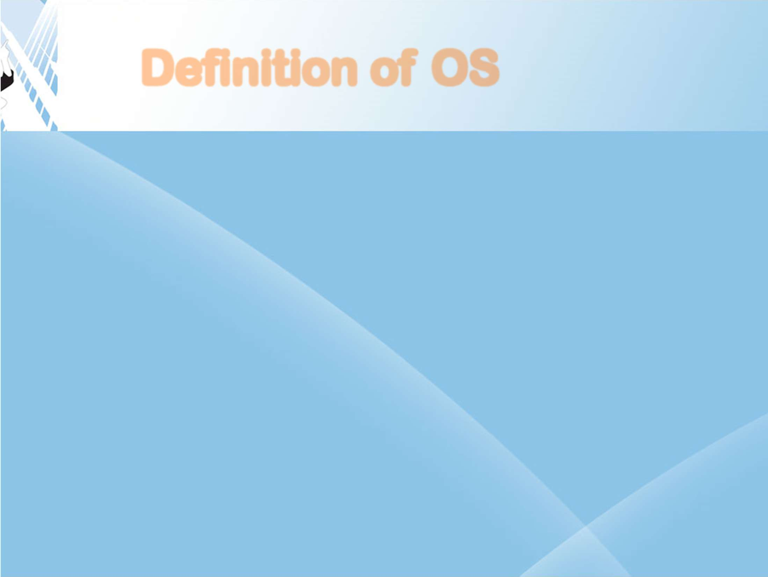






Definition of OS
A more common definition, and the one that we usually follow, is that the operating system is the one program running at all times on the computer—usually called the
Along with the kernel, there are two other types of programs: system programs, which are associated with the operating system but are not necessarily part of the kernel, and application programs, which include all programs not associated with the operation of the system.

Slide 15
Computer System Organization

Slide 16



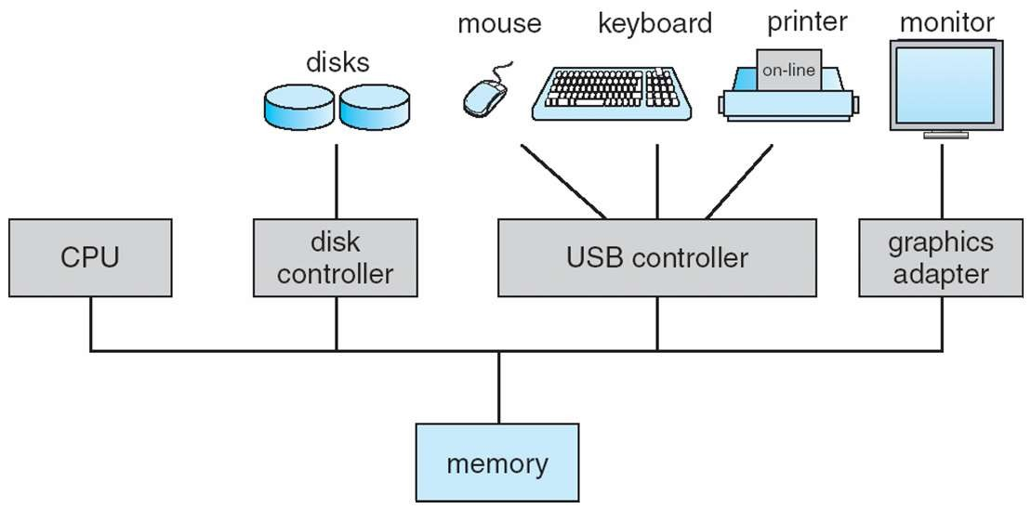
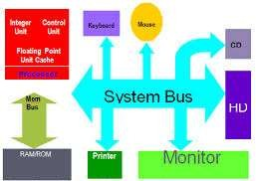
Computer System Organization
A modern general-purpose computer system consists of one or more CPUs and a number of device controllers connected through a common bus that provides access to shared memory.
Each device controller is in charge of a specific type of device.
The CPU and the device controllers can execute in parallel, competing for memory cycles.
To ensure orderly access to the shared memory, a memory controller synchronizes access to the memory.
Operating Systems
14CS3503
Mukesh Chinta, Asst Prof, CSE, VRSEC

Slide 17
Computer Startup
bootstrap program is loaded at power-up or reboot
Typically stored in ROM or EEPROM, generally known as firmware
Initialize all aspects of system
Loads operating system kernel and starts execution
Bootstrap Program
OS
Read OS
OS
ROM
Load OS
Devices
RAM
Start device Drivers
MAIN MEMORY

Slide 18















Computer System Operation
For a computer to start running, when it is powered up or rebooted—it needs to
have an initial program to run called a . It is stored within the computer hardware in
or known by
the general term firmware.
It initializes all aspects of the system, from CPU registers to device controllers to memory contents.
To start execution of the OS, the bootstrap program must locate the Operating- system kernel and load into memory.
Once the kernel is loaded and executing, it can start providing services to the system and its users. Some services are provided outside of the kernel, by system programs that are loaded into memory at boot time to become system processes, or system daemons that run the entire time the kernel is running.
Once this phase is complete, the system is fully booted, and the system waits for some event to occur.

Slide 19









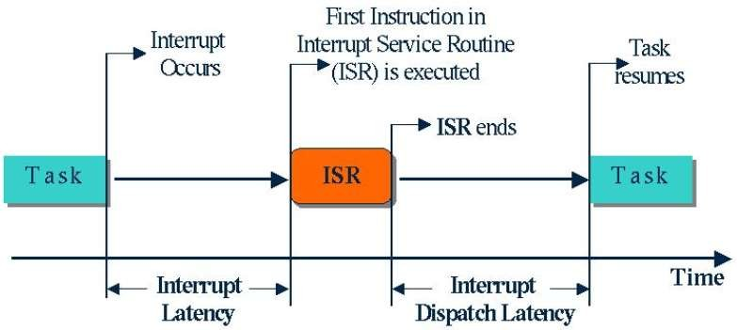
The occurrence of an event is usually signaled by an the hardware or the software.
from either
Hardware may trigger an interrupt at any time by sending a signal to the CPU, usually by way of the system bus.
Software may trigger an interrupt by executing a special operation called a (also called a ).
When the CPU is interrupted, it stops what it is doing and immediately transfers execution to a fixed location.
The fixed location usually contains the starting address where the service routine for the interrupt is located.
The interrupt service routine executes; on completion, the CPU resumes the interrupted computation.

Slide 20
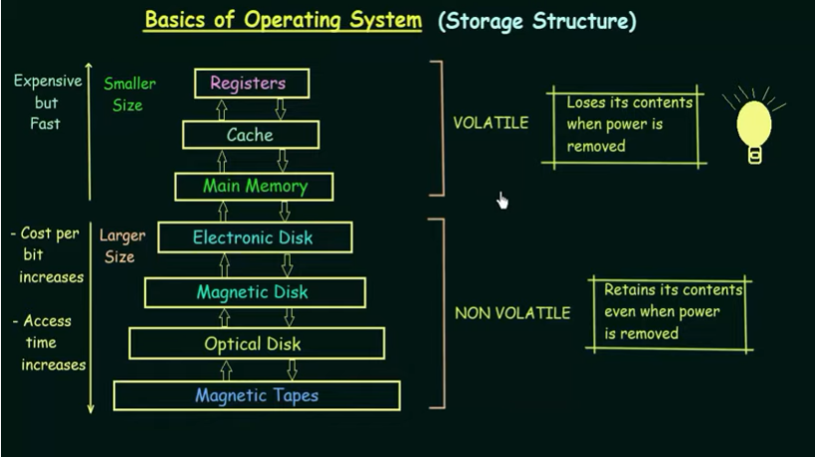
Storage-Device Hierarchy

Slide 21
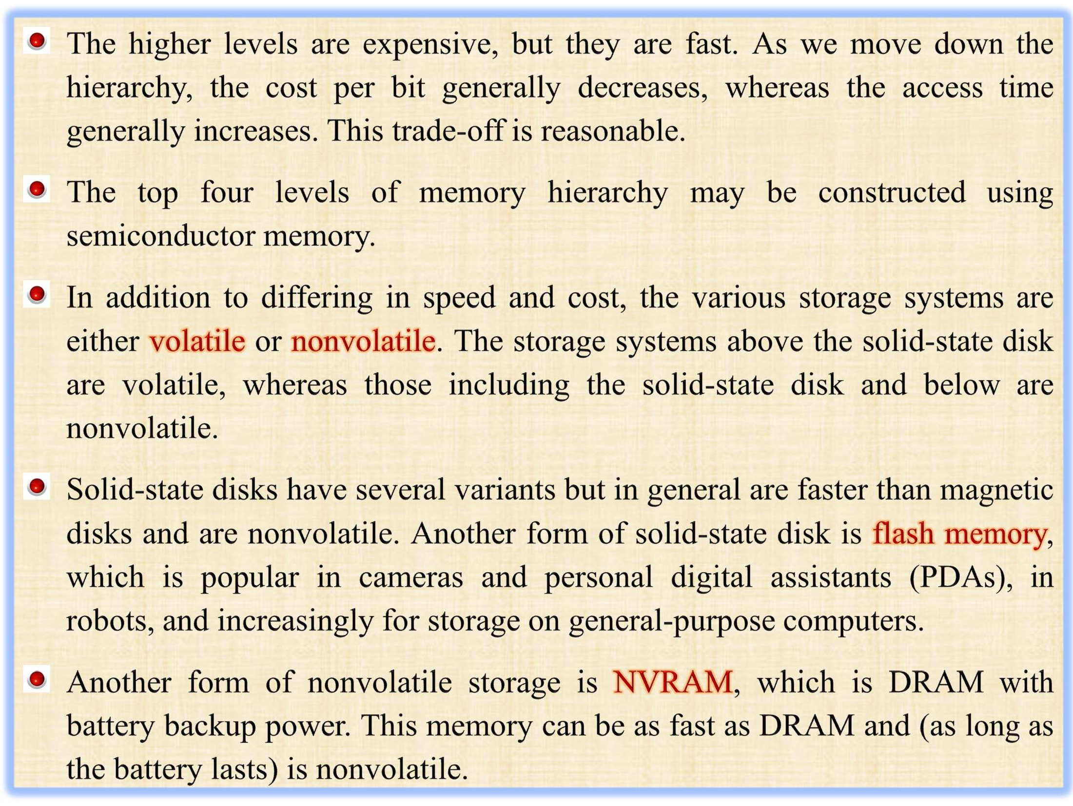

Slide 22
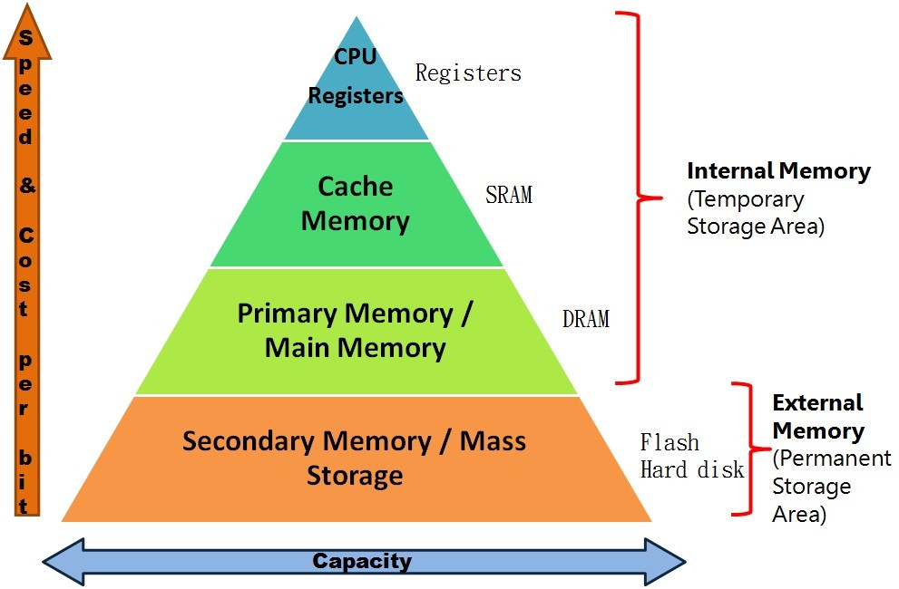


Slide 23
Caching
Important principle, performed at many levels in a computer (in hardware, operating system, software)
Information in use copied from slower to faster storage temporarily
Faster storage (cache) checked first to determine if information is there
If it is, information used directly from the cache (fast)
If not, data copied to cache and used there
Cache smaller than storage being cached
Cache management important design problem
Cache size and replacement policy

Slide 24
How it works

Slide 25
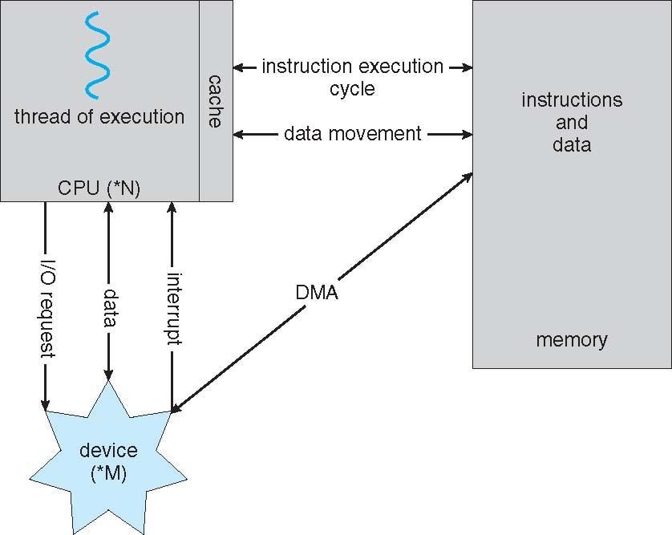
How a Modern Computer Works
A von Neumann architecture

Slide 26
Computer System Architecture

Slide 27

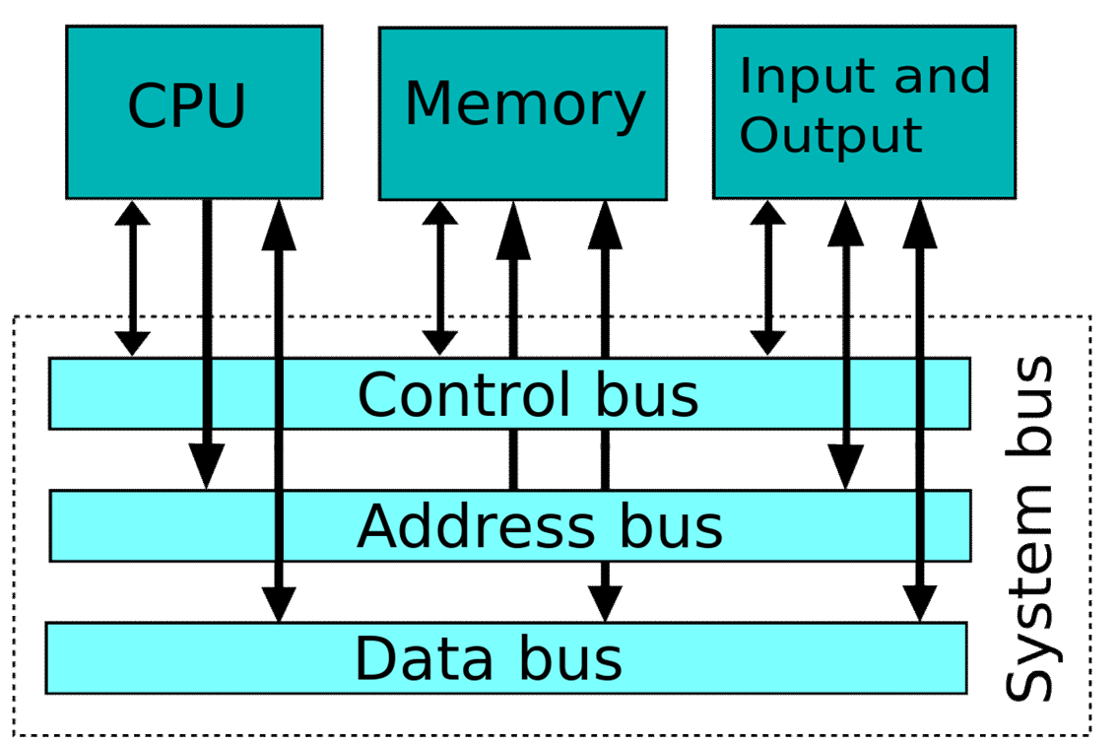
Computer-System Architecture
In computer engineering, computer architecture is a set of rules and methods that describe the functionality, organization, and implementation of computer systems.
A computer system can be organized in a number of different ways, which can be categorized roughly according to the number of general-purpose processors used.

Slide 28




Till recently, most systems use single processor systems. They perform only one process at a given time, and it carries out the next process in the queue only after the current process is completed.
Almost all single processor systems have other special-purpose processors which may come in the form of device-specific processors, such as disk, keyboard, and graphics controllers; or, on mainframes, they may come in the form of more general-purpose processors, such as I/O processors that move data rapidly among the components of the system.
These processors execute only a limited system programs and do not run the user program.
A single processor system is defined as “ A system that has only one general purpose CPU, is considered as single processor system.

Slide 29









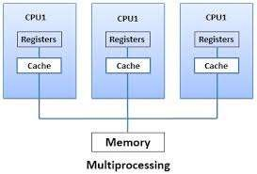
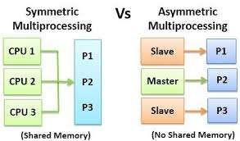
Some systems that have two or more processors are also known as parallel systems or tightly coupled systems.
Mostly the processors of these systems share the common system bus, memory and peripheral (input/output) devices.
These systems are fast in data processing and have capability to execute more than one program simultaneously on different processors.
This type of processing is known as multiprogramming or multiprocessing. Multiple processors further divided in two types.

Slide 30
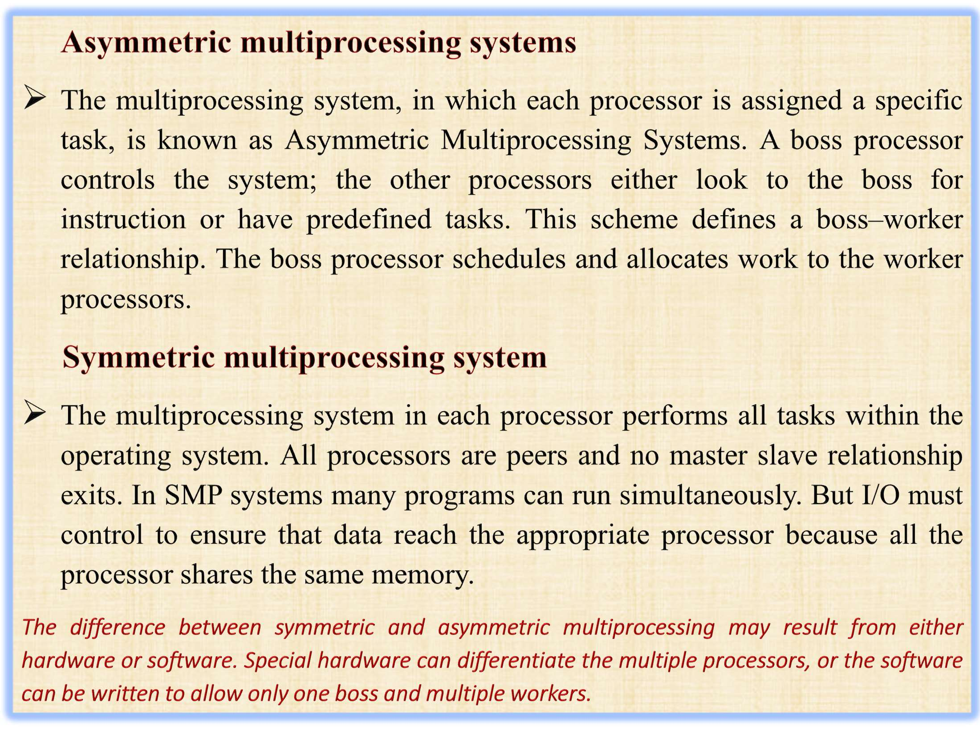



Slide 31
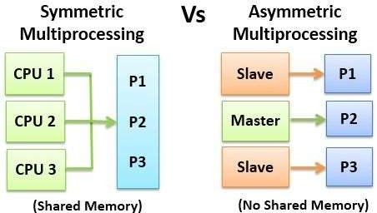
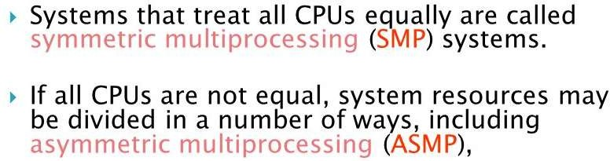

Slide 32
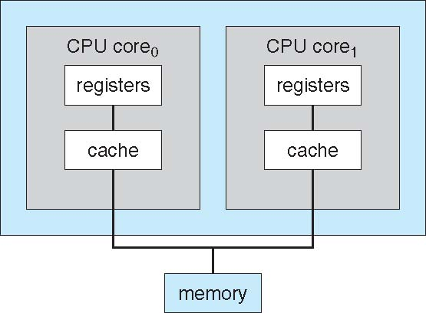
A Dual-Core Design
Multi-chip and multicore

Slide 33
Operating System Structure

Slide 34
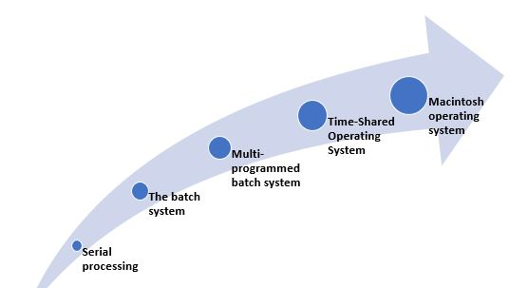
Evolution of Operating Systems

Slide 35
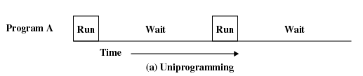
Uniprogramming
Processor must wait for I/O instruction to complete before preceding

Slide 36
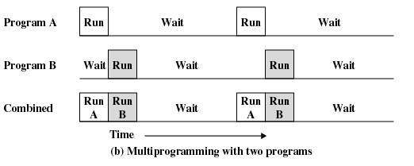
Multiprogramming
When one job needs to wait for I/O, the processor can switch to the other job

Slide 37
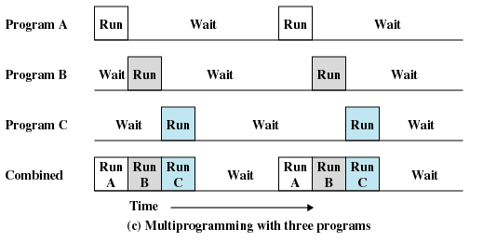
Multiprogramming

Slide 38
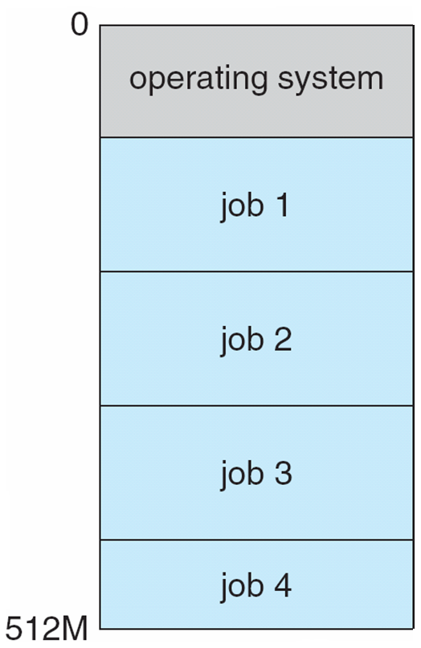
Memory Layout for Multiprogrammed System

Slide 39
Time Sharing
Processor’s time is shared among multiple users
Multiple users simultaneously access the system through terminals
Timesharing is logical extension in which CPU switches jobs so frequently that users can interact with each job while it is running, creating interactive computing
Response time should be < 1 second
Each user has at least one program executing in memory process
If several jobs ready to run at the same time  CPU scheduling
If processes don’t fit in memory, swapping moves them in and out to run
Virtual memory allows execution of processes not completely in memory

Slide 40
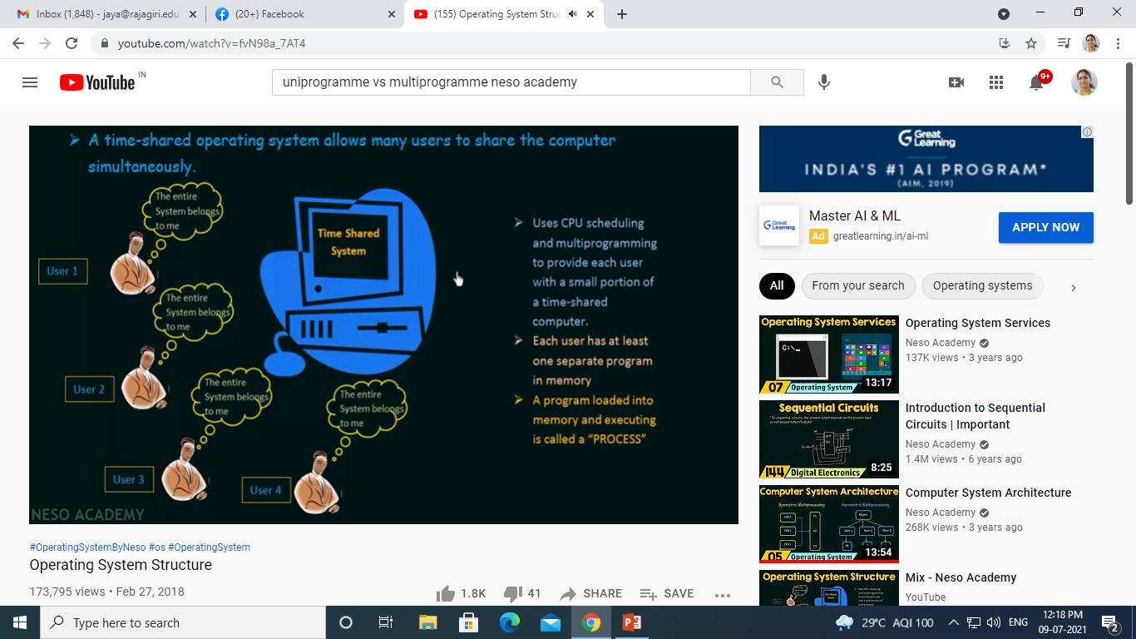

Slide 41
Multithreading
Process is divided into threads that can run concurrently
Thread
Dispatchable unit of work
executes sequentially and is interruptable
Process is a collection of one or more threads

Slide 42
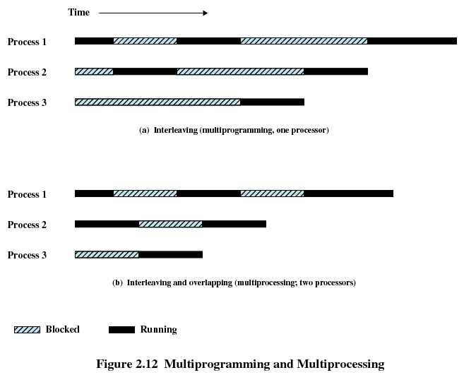
Multiprogramming and Multiprocessing

